Slide 1
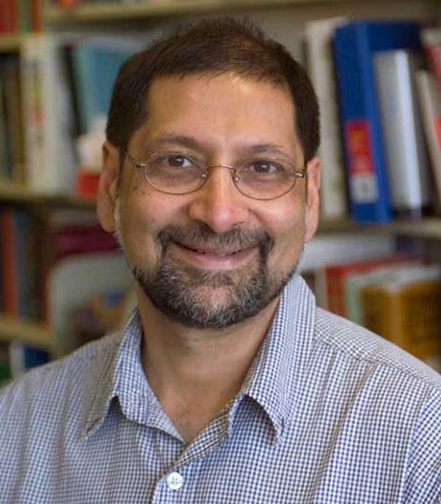
Jeevak Parpia
Notes:
#Name Jeevak Parpia # Textbook Knight, Physics for Scientists and Engineers: A Strategic Approach with Modern Physics, 3rd Edition, Chapter 18 Knight, Physics for Scientists and Engineers: A Strategic Approach with Modern Physics, 3rd Edition, Chapter 37 # Description Chair, Department of Physics, Cornell University, Ithaca NY. Professor, Department of Physics, Cornell University Laboratory of Atomic and Solid State Physics “Professor of physics Jeevak Parpia, M.S. '77, Ph.D. '79, is one of three winners of the 2017 Fritz London Memorial Prize. The prize, administered by Duke University and awarded every three years, recognizes scientists who have made outstanding contributions to the field of low-temperature physics.” Jeevak Parpia studies low temperature physics, including * the physics of highly confined superfluid 3He * disordered superfluids * micro- and nano-mechanical resonators, their design, optimization, non-linear characteristics and the role of stress on these structures and graphene resonators Publications: http://parpia.lassp.cornell.edu/publications # Sources http://parpia.lassp.cornell.edu/ http://www.news.cornell.edu/stories/2017/03/jeevak-parpia-wins-low-temperature-physics-prize # Photo http://physics.cornell.edu/sites/physics/files/Parpia_f_2.jpg

